Slide 1
Chemical Engineering Department
Sodium Polyacrylate
as Sacrificial Adsorption Agent
for Anionic Surfactants*
Hadi ShamsiJazeyi, George J. Hirasaki
____________________________________________________________
* (Patent Pending)
Presented at Rice Consortium for Processes in Porous Media
16th Annual Meeting
Rice University, Houston TX.
April 23, 2012

Slide 2
Agenda
Introduction
Problem Definition
Materials and Methods
Potentiometric titration (surfactant), Colorimetric Measurement (polyacrylate)
Results and Discussions
Polyacrylate vs. different chemicals for Reducing Adsorption of Surfactant
Polyacrylate and Sodium Carbonate on Different Outcrop Minerals
Sodium Polyacrylate for Reducing Adsorption of different Surfactants
Effect of Molecular Weight of Sodium Polyacrylate on its Sacrificial Property
Conclusions
Future Work

Slide 3
Introduction

Slide 4
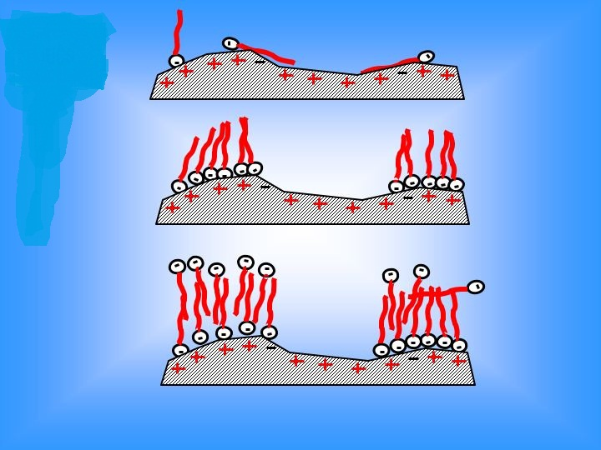
Why is Surfactant Adsorption important?
Enhanced Oil Recovery (EOR)
Surfactant Adsorption & EOR
Economy of Surfactant Injection
Chromatographic Separation
Wettability Alteration

Slide 5
Problem Definition

Slide 6
Anhydrite reacts with Sodium Carbonate
Sodium Carbonate is traditionally used as Sacrificial Agent
Carbonates sometimes contain Anhydrite
Sodium Carbonate is not an effective Sacrificial Agent when Anhydrite is present
Na₂CO₃ + CaSO₄ → Na₂SO₄ + CaCO₃ ↓
Sodium Polyacrylate as Sacrificial Agent?

Slide 7
Materials
and
Methods

Slide 8
Surfactants and Polymers Used
Trade or descriptive name | Chemical Structure | Lot # | Activity (%) | Supplier
Neodol-67 | bC16-17(CH3-CH-CH2-O)7-SO3 | 16920-12765-1.00 | 22.88 | STEPAN
IOS15-18 | R-CH(OH)-CH2-CH(SO3)-R (~75%) R-CH=CH-CH(SO3-)-R (~25%) where R+R’ = C12-15 | 16920-113005-1.15 | 21.29 | STEPAN
Petro-step S13B |  |  |  | TIORCO
NI-Blend | A Blend of Neodol-67 and IOS15-18 (N:I)=4:1
FLOSPERSE 1000 | Sodium Polyacrylate (Mw=2200 Da) | RLQ02A1201 | 44 | SNF
FLOSPERSE 3000 | Sodium Polyacrylate (Mw=4500 Da) | RLQ01A1208 | 44 | SNF
FLOSPERSE 15000 | Sodium Polyacrylate (Mw=150 KDa) | RLQ02A1367 | 30 | SNF
FLOPAM AN 995 BPM | Sodium Polyacrylate (Mw~3 MDa) | UB6065 | 100 | SNF
ACUMER 1100 | Sodium Polyacrylate (Mw=4500 Da) | 10081977 | 47-49 | DOW Chem.
Poly(acrylic sodium salt) | Sodium Polyacrylate (Mw= 5100 Da) | 0001393719 | 100 | Sigma-Aldrich

Slide 9
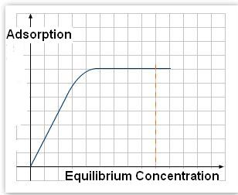
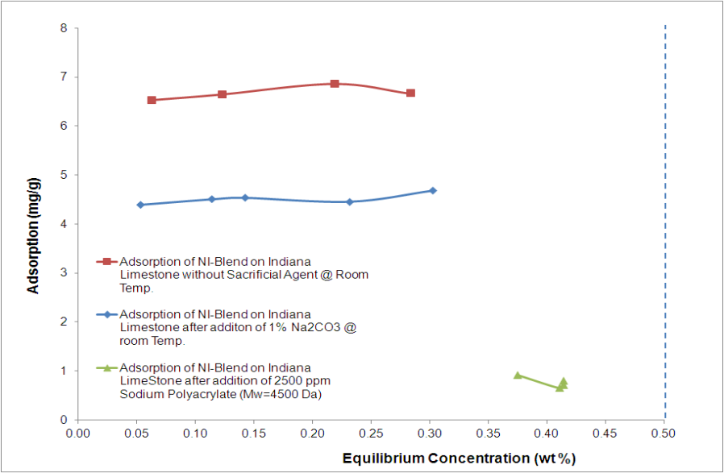
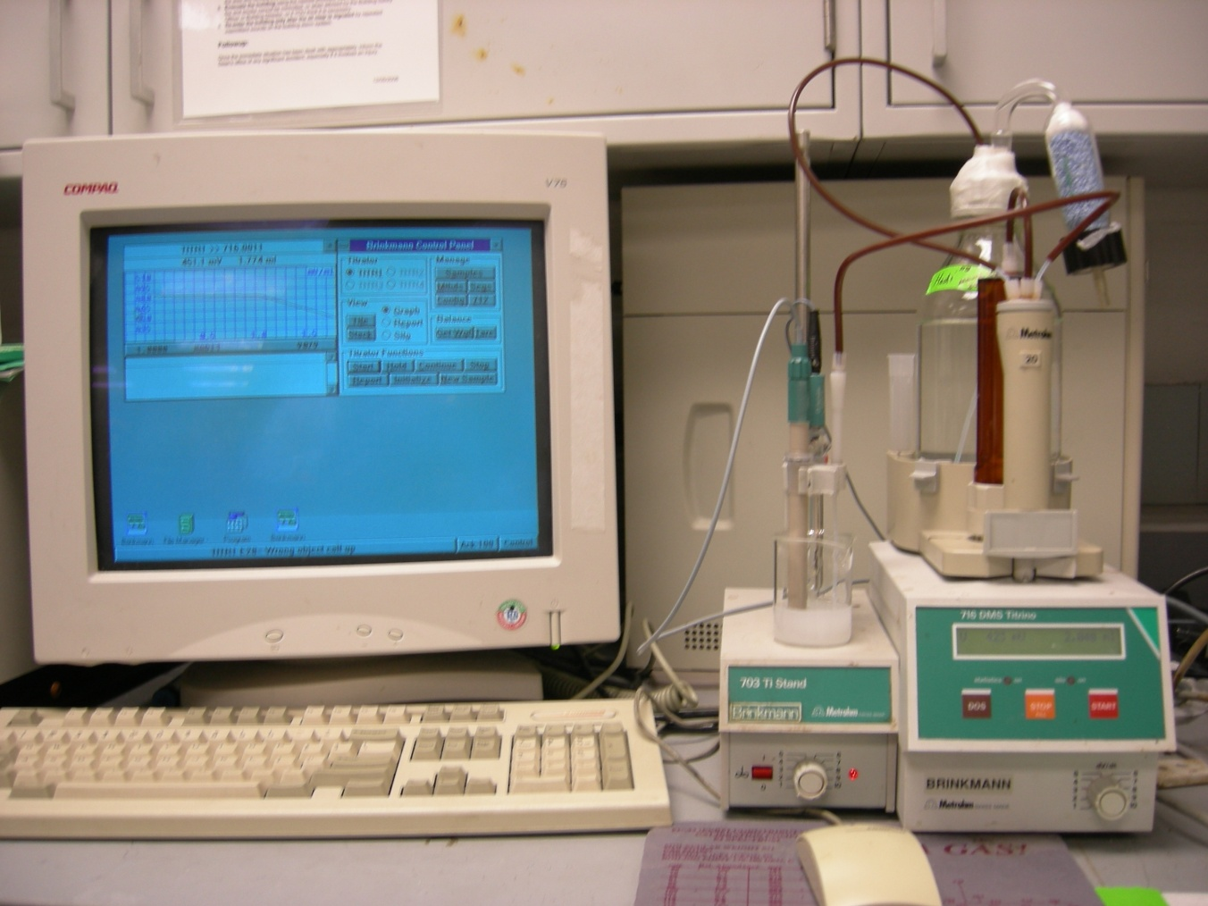
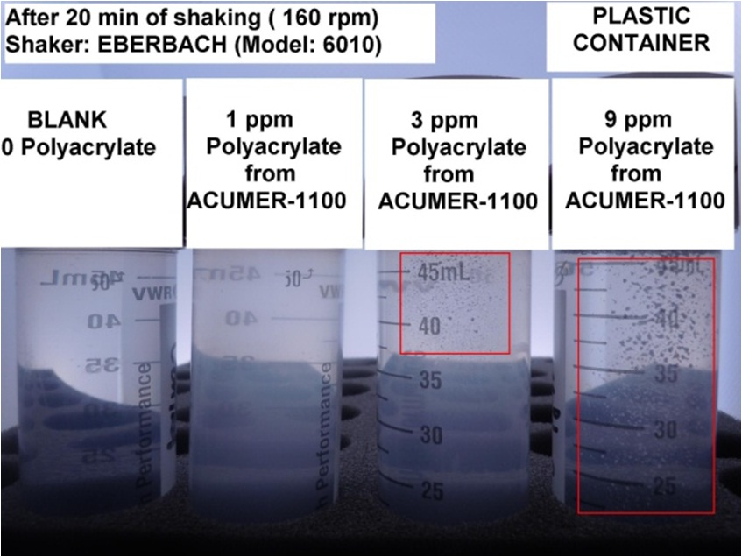
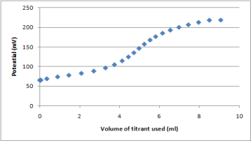
Surfactant/Polymer Adsorption Measurement Plateau Region of Langmuir isotherm
No Sacrificial Agent
1 wt % sodium carbonate
Plateau Region
2500 ppm Na-Polyacrylate
Potentiometric Titration for
Surfactant Concentration
Colorimetric Method for
Polyacrylate Concentration

Slide 10
Results
And
Discussions

Slide 11
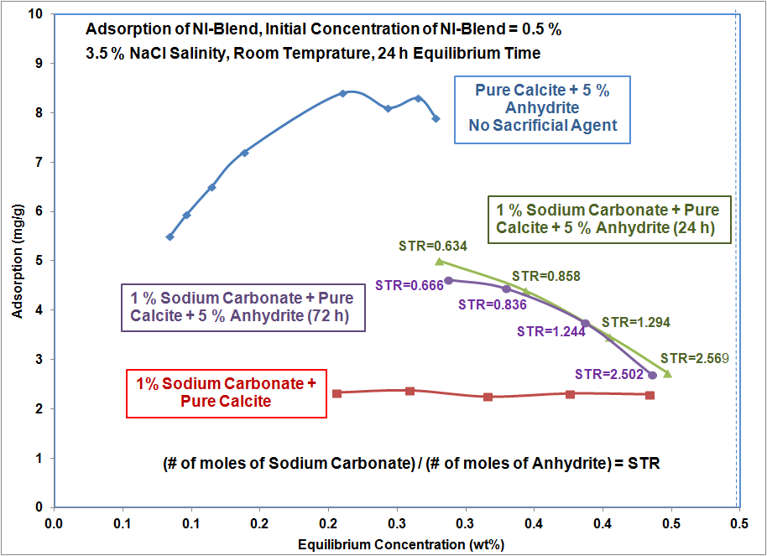
How Anhydrite Can Affect Sodium Carbonate as Sacrificial Agent

Slide 12
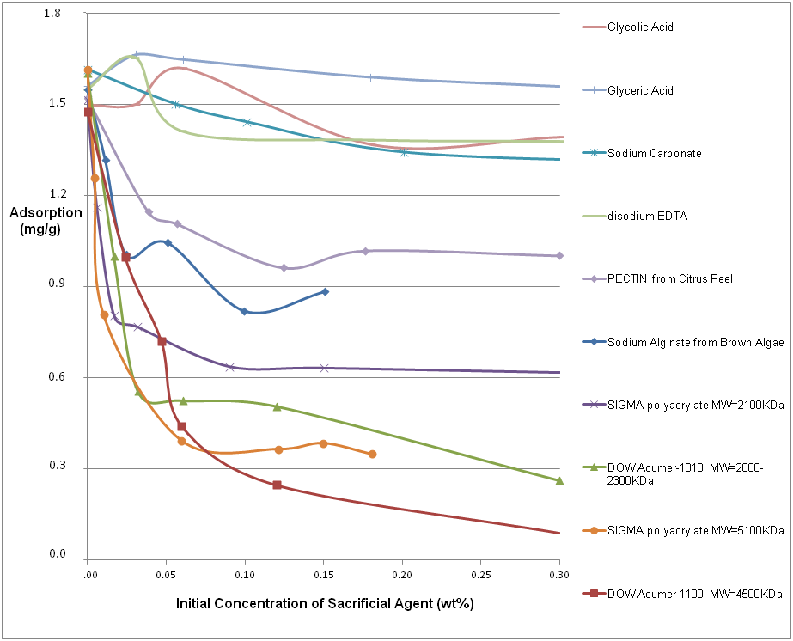
Reducing Adsorption of Surfactant Polyacrylate vs. different chemicals
Sodium Polyacrylate

Slide 13
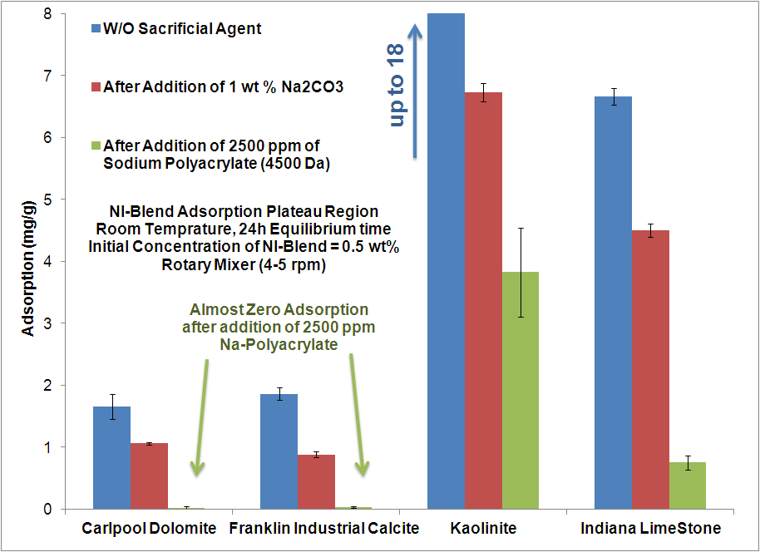
Polyacrylate and Sodium Carbonate on Different Outcrop Minerals

Slide 14
Sodium Polyacrylate for Reducing Adsorption of different Surfactants

Slide 15
Effect of Molecular Weight of Sodium Polyacrylate on its Sacrificial Property

Slide 16
Adsorption of Sodium Polyacrylate (Mw=4500 Da) on Carlpool Dolomite
NI-Blend Adsorption

Slide 17
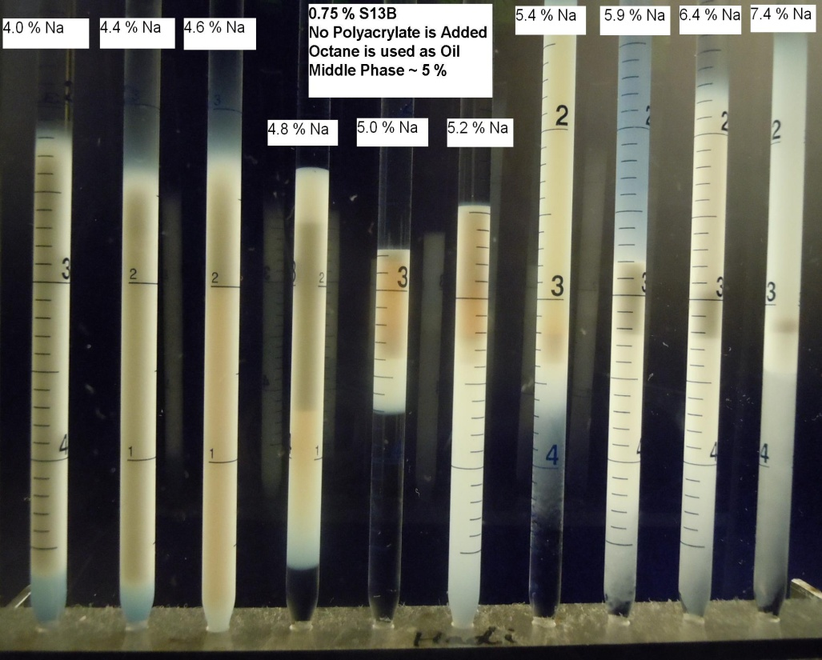
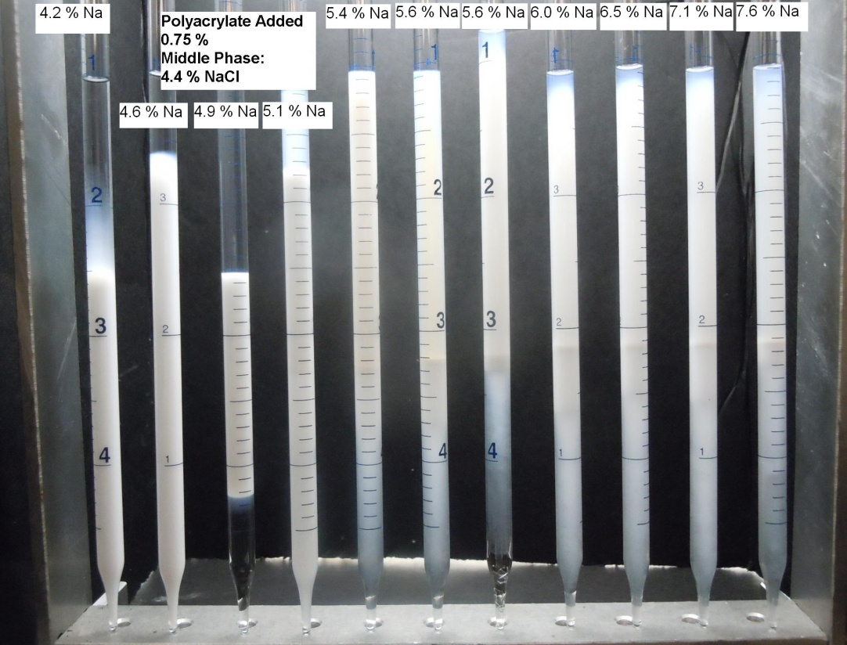
Effect of Polyacrylate on Phase Behavior
% NaCl = 0 4.4 4.6 4.8 5.0 5.2 5.4 5.9 6.4 7.4
Cø ~ 5.0 %
0 % Polyacrylate + 0.75 % S13B + n-Octane
% NaCl = 4.2 4.6 4.9 5.1 5.4 5.6 5.6 6.0 6.5 7.1 7.6
Cø ~ 4.6% NaCl , if
Polyacrylate not in salinity
Cø ~ 4.9 % Na+
0.75 % Polyacrylate + 0.75 % S13B + n-Octane

Slide 18
Conclusions

Slide 19
Conclusions
Sodium Polyacrylate shows the highest reduction in adsorption of anionic surfactants among many other candidates.
Regardless of type of anionic surfactant, mineral, or the commercial provider of the polyacrylate, it reduces the adsorption of surfactant much better than sodium carbonate.
Higher Molecular Weights of Polyacrylate lead to higher reductions in adsorption of surfactant until Mw=4500 Da after which Molecular Weight Does not Play Role.

Slide 20
Conclusions (…Continued)
The fact that Mw not higher than 4500 Da is needed for Sacrificial Agent wipes out any worries about possible limitations of this application due to precipitation or degradation of high molecular weight polymers in the presence of hardness.
Adsorption of Sodium Polyacrylate (MW=4500 Da) on Carlpool Dolomite is at least ¼ of adsorption of NI-Blend.
Adsorption of Polyacrylate does not change significantly with the presence of surfactant.
Polyacrylate does not seem to change phase behavior if the ionic strength effect is considered.

Slide 21
Future Work
Effect of Sodium Polyacrylate on Adsorption of other Surfactants, Especially Betaines.
Effect of Salinity and Hardness on Effectiveness of Sodium Polyacrylate (Mw=4500 Da).
Dynamic Adsorption Tests.
High-Temperature Long-Term Stability of Sodium Polyacrylate (Mw=4500 Da).

Slide 22
Thank You!

Slide 23
Back-Up
Slides

Slide 24
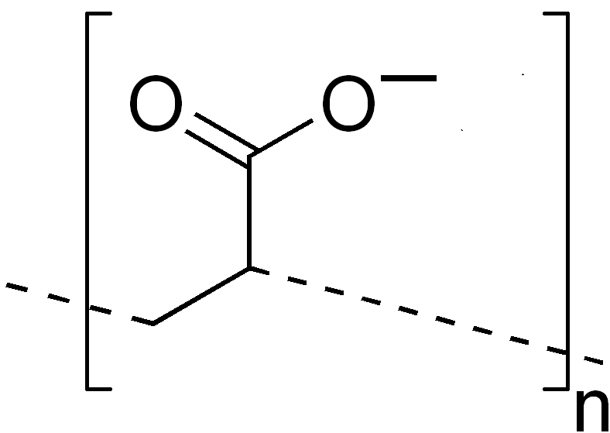
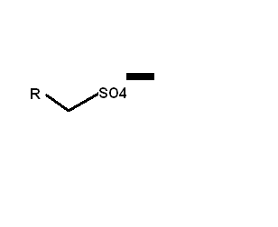
Is Polyacrylate Affecting the titration of Surfactant?
Sodium Polyacrylate has negative charge in neutral pH
Does this mean that Sodium Polyacrylate can interfere with measuring concentration of anionic (sulfate-based) surfactant?
Surfactant has
negative charge in neutral pH

Slide 25
Is Polyacrylate Affecting the titration of Surfactant? (…Continued)
Our strategy is to do the potentiometric titration at pH=3 so that the polyacrylate does not have any charge, but sulfate-based anionic surfactant does.

Slide 26
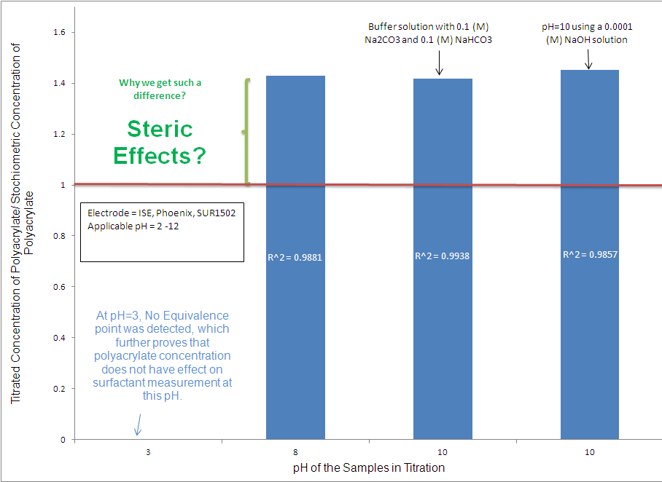
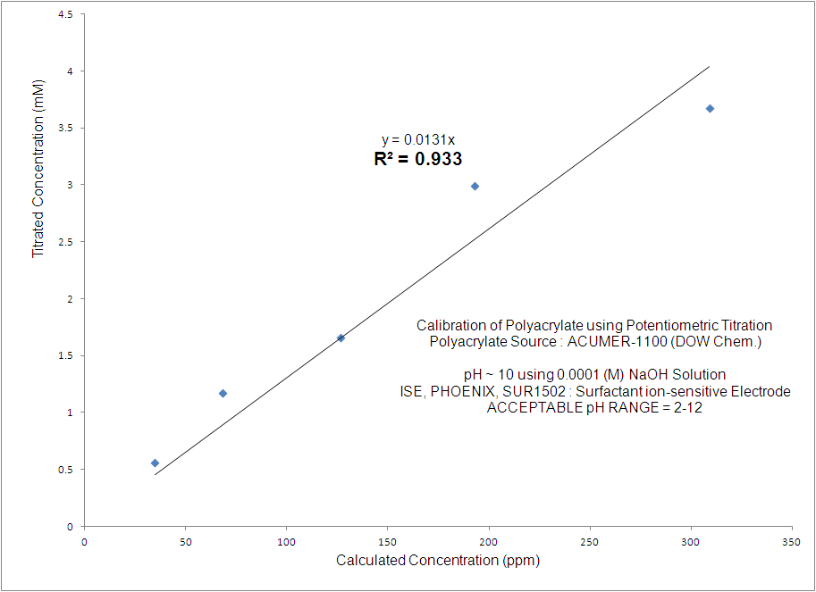
Measurement of Concentration of Sodium Polyacrylate (Unsuccessful Potentiometric Titration)

Slide 27
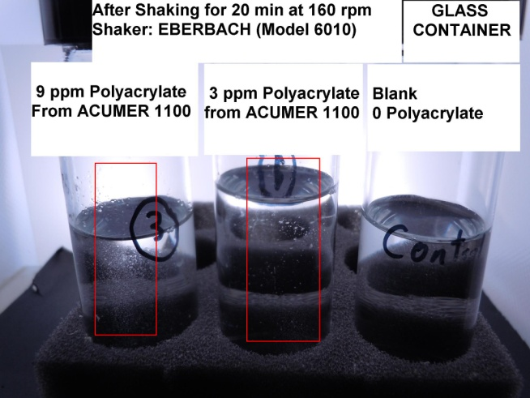
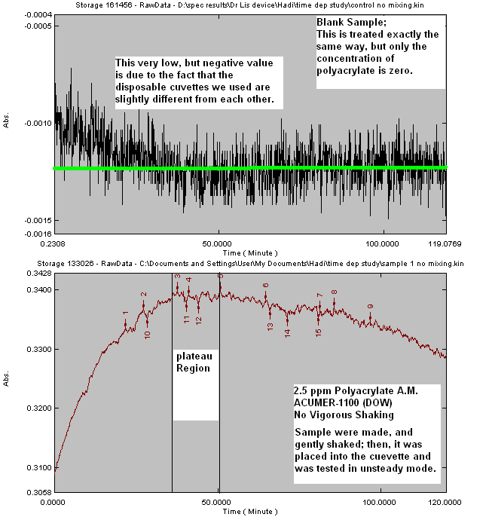
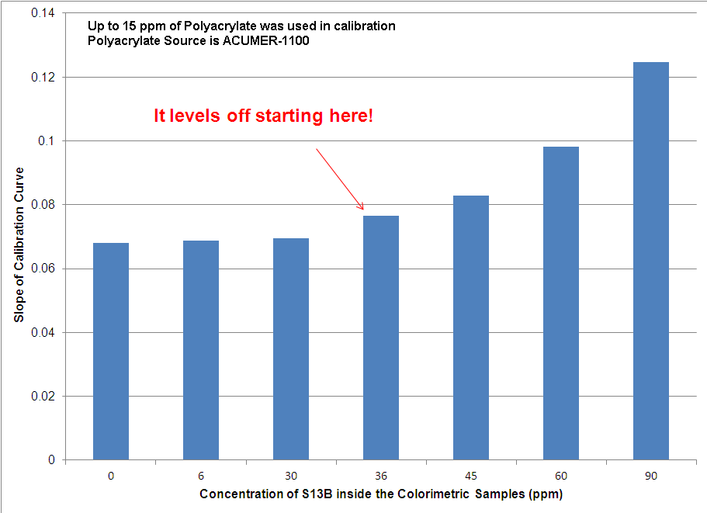
Measurement of Concentration of Sodium Polyacrylate (Colorimetric Method)
Effect of S13B On Colorimetric
Measurement

